Slide 1
New Mexico Environment Department
NMED RCRA Corrective Action Process
KAFB BFF Public Meeting
July 23, 2020

Slide 2
NMED Guiding Principles
Our four guiding principles are the means by which we protect and restore the environment and foster a healthy and prosperous New Mexico for present and future generations.
Science – Using the best available science and data to inform our decision-making in protecting public health and the environment.
Innovation – Employing creative engineering and technological solutions to address environmental problems.
Collaboration – Engaging communities and interested stakeholders in environmental decision-making.
Compliance – Ensuring meaningful compliance with state regulations and permits.

Slide 3
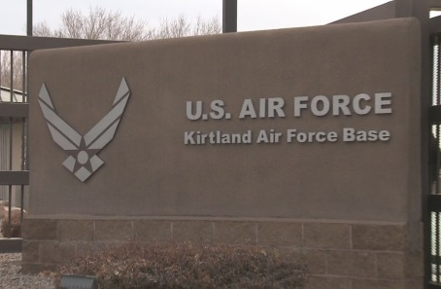
Regulatory Authority
Regulations
Federal Resource Conservation and Recovery Act (RCRA)
New Mexico Hazardous Waste Act (HWA)
New Mexico Hazardous Waste Permit and Corrective Action Fee Regulations [20.4.2 NMAC]
KAFB Permit (EPA ID# NMD9570024423; NM ID# 2400)
Governs the Corrective Action Process
Contains requirements for Corrective Action Process
https://www.env.nm.gov/hazardous-waste/kafb/

Slide 4
Corrective Action Process
Facility Assessment
RCRA Facility Investigation (RFI)
Corrective Measures Evaluation (CME)
Corrective Measures Implementation (CMI)
Remedy Selection

Slide 5
Facility Assessment
Identify
Identify sites where releases of hazardous waste or hazardous constituents may have occurred.
Assess
Assess to determine if releases have or are suspected to have occurred.
Investigate (RFI)
Define the nature and extent of contamination and collect data sufficient to allow evaluation of remedial alternatives and select a remedy if clean up is necessary.

Slide 6
RCRA Facility Investigation (RFI)
RFI (KAFB Permit Section 6.2.4)
Define the nature and extent of contamination
Groundwater
Soil/Soil Vapor
Surface Water
Data must be sufficient to:
Evaluate remedial alternatives
Select a clean up remedy
May include multiple phases, ongoing monitoring, and pilot testing.

Slide 7
RFI (Cont’d)
Workplans
(Proposed Investigations)
Environmental Sampling/Monitoring
Pilot Tests & Interim Measures
Report
(Summarize Results,
Propose Recommendations)

Slide 8
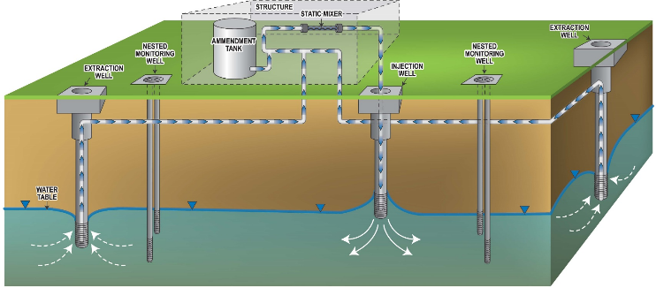
RFI (cont’d)
Interim Measures (KAFB Permit Section 6.2.2.2.12)
A temporary remedy implemented in response to an immediate threat to human health or the environment.
May be implemented as part of the RFI process or as part of a remedy evaluation.
Interim measures can become part or all of a final remedy.
Example: Groundwater
Pump and Treat System
to protect drinking
water wells.

Slide 9
Corrective Measures Evaluation (CME)
CME Report (KAFB Permit Section 6.2.2.2.3)
Evaluates remedial alternatives for the purpose of selecting a final remedy to cleanup a site to meet applicable cleanup standards for all media.
Cannot be prepared until site characterization is complete.
Permittee prepare a CME Report that evaluates potential remedial alternatives and identifies a preferred remedy.
Several remedial options must be evaluated and presented for consideration, ranging from no action to complete removal of contaminants.

Slide 10
Remedy Selection
NMED (Regulatory Authority) Selects Remedy(ies) (KAFB Permit Section 6.2.2.2.5)
Does remedy meet clean up standards?
Does remedy meet threshold criteria?
Does remedy meet remedial alternative evaluation criteria?

Slide 11
Remedy Selection (cont’d)
REMEDY
Protect human health and the environment
Attain clean up standards
Control/Eliminate Contamination Source
Comply with hazardous waste management standards
Threshold Criteria

Slide 12
Remedy Selection (cont’d)
REMEDY
Long-term reliability and effectiveness
Cost
Short-term effectiveness
Reduction of Toxicity, Mobility, and Volume
Implementability
Remedial Alternative Evaluation Criteria

Slide 13
Remedy Selection (Cont’d)
NMED selects proposed remedy(ies) and/or proposes different remedy

Slide 14
Remedy Selection (cont’d)
Public Participation (KAFB Permit Section 6.2.2.2.6)
Upon approval of the CME, NMED issues Statement of Basis that justifies the selected remedy(ies) for public comment.
NMED follows the public participation requirements applicable to remedy selection under 20.4.1.901 NMAC and 40 C.F.R. Part 270.
This includes the
opportunity for
commenters to request
a public hearing
in accordance with
20.4.1.901 NMAC.

Slide 15
Remedy Selection (Cont’d)
NMED will, after consideration of public comments, select a FINAL REMEDY and issue a response to all public comments after the end of the public comment period.
NEXT: Corrective Measures Implementation Plan

Slide 16
Corrective Measures Implementation (CMI) Plan
CMI (KAFB Permit Sections 6.2.2.2.7 & 6.2.2.2.8
Workplan
(Construction timeline)
Implementation & Monitoring
Progress Reports Summarizing Results & Effectiveness
(Concentration/Mobility)

Slide 17
Questions?
Kevin Pierard, Chief
Hazardous Waste Bureau
Kevin.Pierard@state.nm.us
Thank You!

